Slide 2
MediConnect
Submitted to:
Department of Computer Science and Engineering

Slide 3
Supervised by: Prof. Ritika Bhatt
Team Members
1. Ishant Mandloi (0827CS211105)
2. Jigyansh Sisodiya (0827CS211111)
3. Krishna Bhawsar (0827CS211128)
4. Krishna Gupta (0827CS211129)
5. Kunal Yadav (0827CS211132)

Slide 4
Project Presentation Outline
Introduction
Problem Statement
Survey of Existing Systems
Project Objectives
Requirement Analysis
Solution Proposed
Expected Outcome

Slide 5
Introduction
The field of healthcare stands as one of the most dynamic and promising domains for innovation. The project titled “MediConnect" represents a critical step forward in leveraging technology to overcome barriers and enhance the accessibility of healthcare services.
Our software seeks to revolutionize the healthcare landscape by providing innovative solutions that enhance efficiency, accessibility, and quality of care.

Slide 6
The Problem Statement
Telemedicine Platform
The challenge is to improve healthcare access for individuals, especially in remote areas, by creating a user-friendly Telemedicine Platform that facilitates online consultations and enhances the overall healthcare experience.

Slide 7
The motivation behind undertaking specific problem
We chose to work on this project because we want to help people get better healthcare. Sometimes, it's hard for people to see a doctor, especially if they live far away.
But with our project, we can make it easier for anyone to talk to a doctor through the internet. We believe this will make healthcare better for everyone and give people more control over their health.

Slide 8
Survey of Existing Systems
Tata1mg
Characteristics:
User friendly interface with a wide range of options
Offers diagnostic tests and health check-up packages, user could book appointments
Advantages:
It offers convenience of ordering medicines and booking healthcare services online, saving users time
It has an extensive selection of medicines and healthcare products, making a one-stop-shop.
Disadvantages:
Services and delivery options may not have been available in all regions of India.
The platform relied on internet connection, which could be a barrier in areas with poor connectivity.

Slide 9
Survey of Existing Systems
Practo
Characteristics:
Platform that connects patients with a range of healthcare services including doctors, specialists and hospitals.
Users can book appointments with healthcare providers, view their availability, and manage their schedules.
Advantages:
Patients can find and consult with specialists who may not be available locally.
EHR systems help in maintaining and accessing medical records, leading to consultations and continuity of care.
Disadvantages:
Storing and transmitting medical data online may raise privacy and security concerns.
Some premium services may come with associated costs and may not be affordable for everyone.

Slide 10
Objectives
Objectives while developing the software
User-Friendly Interface
Secure Data Transmission
Appointment Scheduling
Mobile Compatibility
Feedback Mechanism

Slide 11
Requirement Analysis
Functional Requirements:
User Registration and Authentication:
Users must be able to create accounts with secure authentication.
Patients and healthcare providers should have separate registration processes.
Appointment Scheduling:
Patients should be able to view the availability of healthcare providers and schedule appointments.
Users should receive confirmation and reminder notifications for scheduled appointments.

Slide 12
Functional Requirement
3. Telemedicine Consultations:
The platform should support real-time video, audio, and text-based telemedicine consultations.
Patients and healthcare providers must have access to a virtual waiting room for scheduled consultations.
4. Prescription Management:
Healthcare providers must be able to electronically prescribe medications and treatments.
Patients should have access to their prescription history.

Slide 13
Non Functional Requriement
Performance:
The platform must load within 3 seconds for users on standard internet connections.
It should handle a minimum of 500 simultaneous telemedicine sessions without performance degradation.
Security:
Data transmission must use encryption protocols (e.g., HTTPS) to protect sensitive information.
User authentication must follow industry best practices, including multi-factor authentication options.

Slide 14
Non Functional Requirement
3. Usability and User Experience:
The user interface should be intuitive and easy to navigate for users of varying technical backgrounds.
The platform should be responsive and functional on various devices and screen sizes.

Slide 15
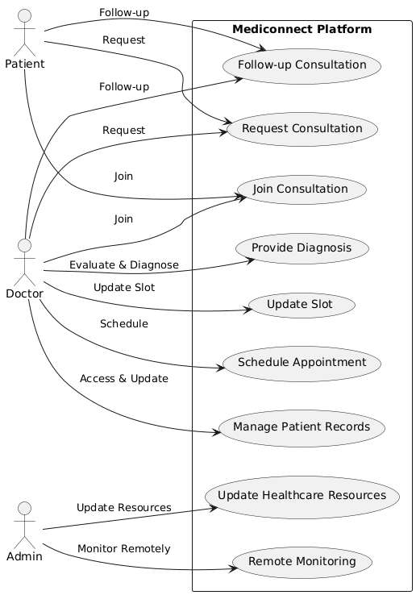
Use Case Diagram

Slide 16
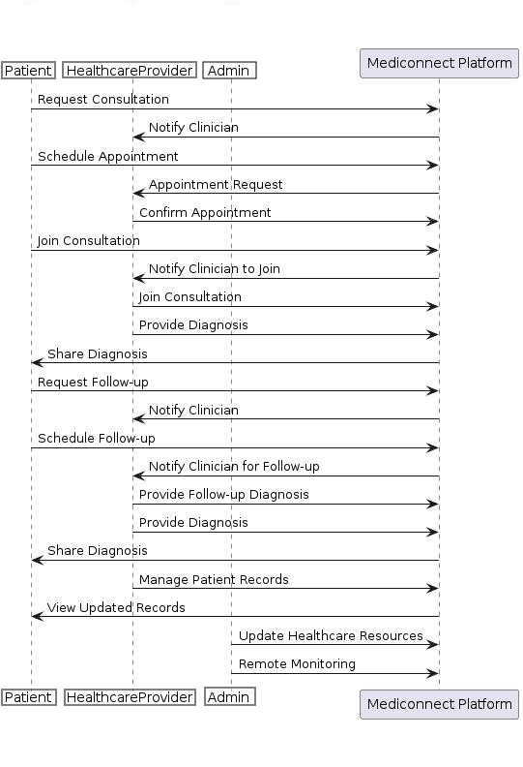
Sequence Diagram

Slide 17
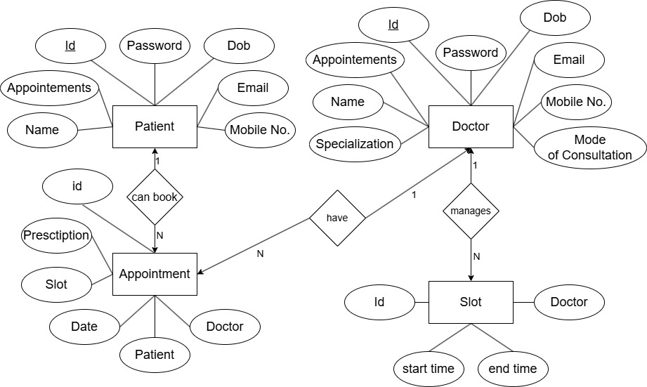
ER Diagram

Slide 18
Solution Proposed
Develop a user-friendly interface for both patients and healthcare providers. The platform should be easy to navigate and use, with clear options for appointment scheduling and video consultations.
Implement a robust appointment booking system that allows patients to schedule appointments with healthcare providers at their convenience. Include features for rescheduling and cancellations.
Prioritize data security and compliance with healthcare regulations. Ensure end-to-end encryption for video consultations and secure storage of patient data.

Slide 19
Expected Outcome
The expected outcomes of the Telemedicine Platform project encompass a range of benefits and positive impacts on healthcare accessibility, patient care, and healthcare providers.
The users and rural population can easily connect to the doctors through video consultation.

Slide 20
Acknowledgment
I would also like to express my appreciation to Acropolis Institute of Technology and Research for providing us with the resources, infrastructure, and conducive environment that allowed us to pursue this project with enthusiasm and dedication.

Slide 21
Q&A

Slide 22
THANKS

